Slide 1

Project 4 – Monte carlo
Malvin Varpe &
Torgrim Odde
Notes:
I will start, Malvin will cover the second part and conclude project 4 – our final project for this course.

Slide 2
Agenda
Governing Theory
Monte Carlo Mixing Tanks
  Option 1 – Fixed Parameters
  Option 2 – Time Varying Parameters
Validation Against ODE
Random Walk In Aquifers
  Unbiased vs Biased
  Risk Assessment
Conclusions & Learning Outcomes
Notes:
This project covers both mixing tanks dynamics and groundwater transport
The project presentation follow the project build-up and exercises
We start from a simple mass balance and build up to full stochastic simulation
Goal of the project
Use Monte Carlo to model uncertainty
Validate against deterministic ODE
Compare risk scenarios

Slide 3

Governing Theory
Single Tank Equation:
$\frac{dC}{dt}=\frac{Q_{in}}{V}C_{in}−\frac{Q_{out}}{V}C$
Analytical solution:
$C\left(t\right)=C_{ss}+\left(C_{0}−C_{ss}\right)e^{−\frac{Qt}{V}}$
Notes:
We start with a perfectly mixed single tank.
The governing equation comes from a standard mass balance, and the solution is exponential decay toward the steady-state determined by inflow concentration
Monte Carlo should match it in expectation, we will come back to that later on.

Slide 4
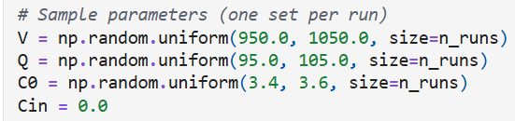
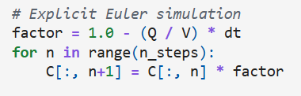
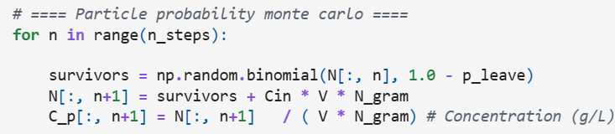
Monte Carlo Mixing Tanks
Option 1:
Fixed parameter per run
Option 2:
Parameters vary each step
Outputs: Mean, Confidence Interval, Standard Deviation
Notes:
Monte Carlo concept
We have uncertainty from volume (V), flow (Q) and initial concentration
We then repeat the simulation many times, sample parameters and compute
Mean, Standard deviation and Confidence Intervals
As a result, we get not only a prediction, but also the range of outcomes
In our project, Monte Carlo is used to propagate parameter uncertainty with two methods
Option 1: each run has fixed parameters (and we simulate for 100 runs, 1000 steps)
What’s important to mention is that we introduced the particle probability and used this for simulating the best and most realistic results
The code snippets show how we implement the Particle Probability, Explicit Euler and set Sample parameters

Slide 5
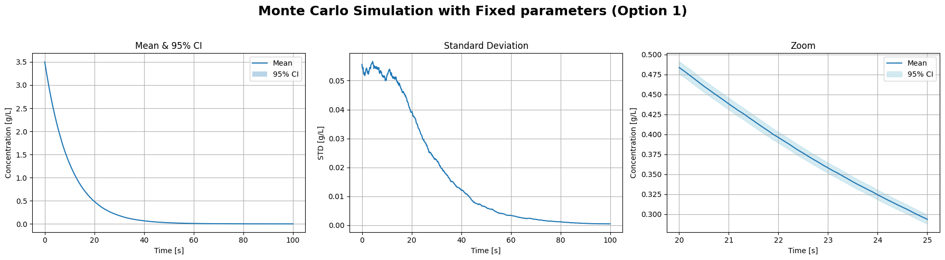
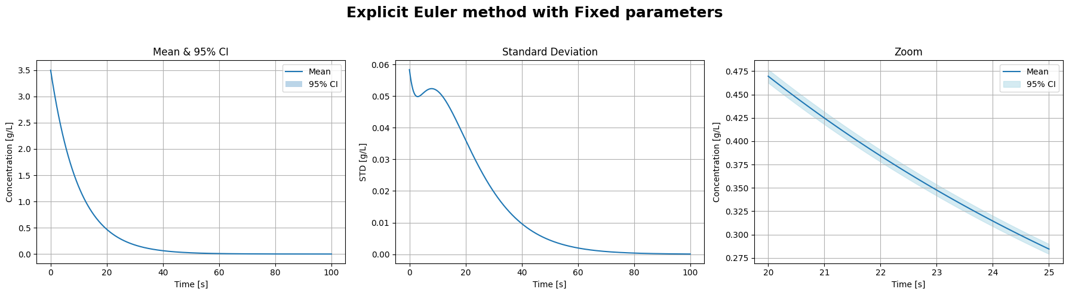
Notes:
Here, we showcase the Monte Carlo simulations (with particle probability) next to the “perfect” explicit Euler
What we can see from the plot
The mean closely follow the analytical decay (purely exponential), showing robustness of the system
The particle Monte Carlo adds sampling noise to the simulations
The confidence intervals are very narrow (which is why we zoom in on plot 3 iot visualize it)
Uncertainty at this stage is dominated by
Initial concentration and decay rate

Slide 6
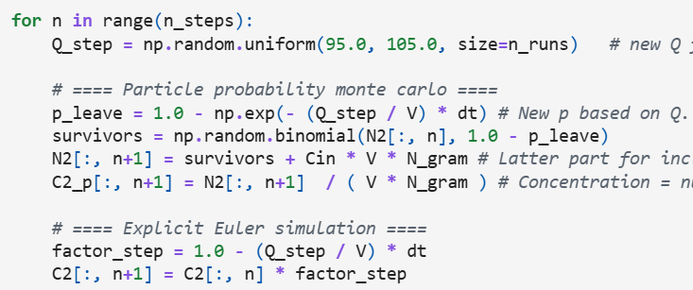
Monte Carlo Mixing Tanks
Option 1:
Fixed parameter per run
Option 2:
Parameters vary each step
Outputs: Mean, Confidence Interval, Standard Deviation
Notes:
Option 2: flow rates vary dynamically
We resample flow rate Q(t) at every time step
Volume and initial concentration are till fixed

Slide 7
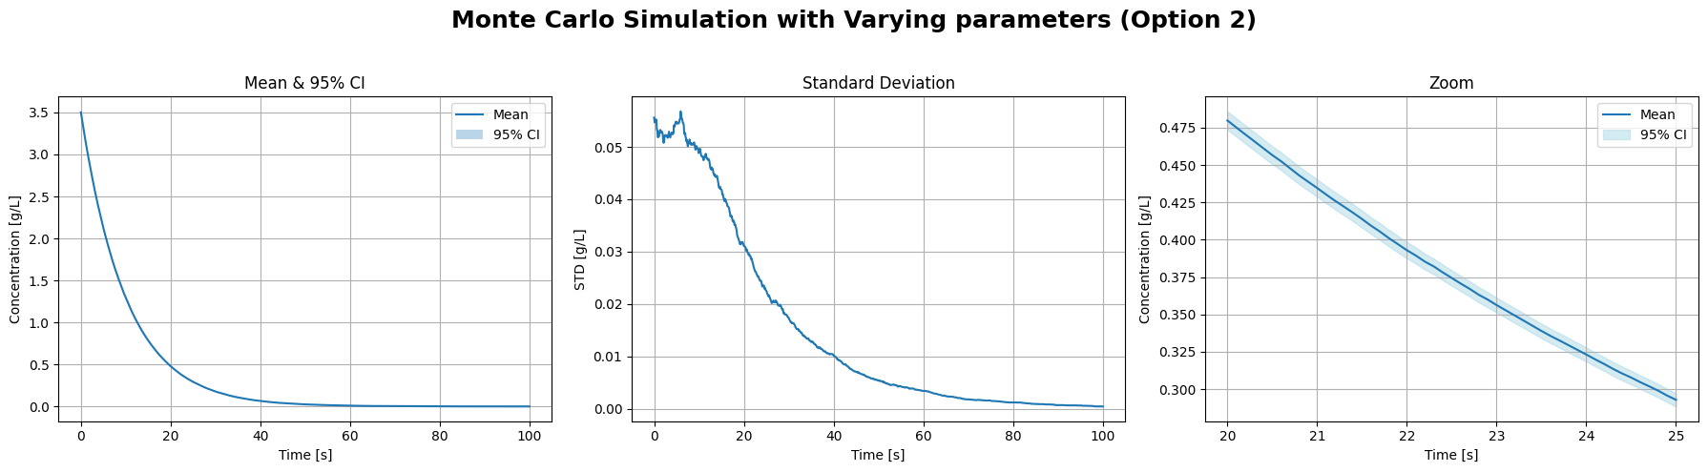
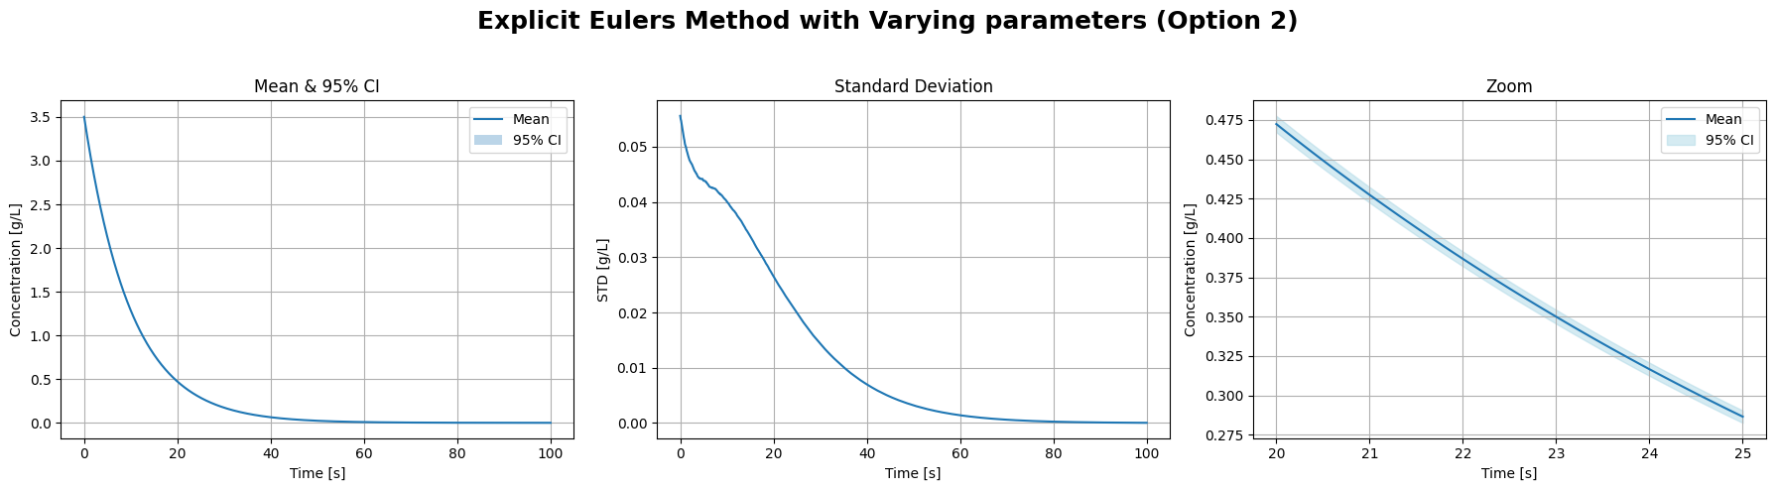
Notes:
Again, we compare the Monte Carlo simulation with the explicit Euler
What we can see from the plot
Both means closely follow the analytical decay (purely exponential), showing robustness
Again, the key difference lie in the standard deviations
Even with fluctuation flow, the average behavior is close to identical
Uncertainty changes slightly

Slide 8
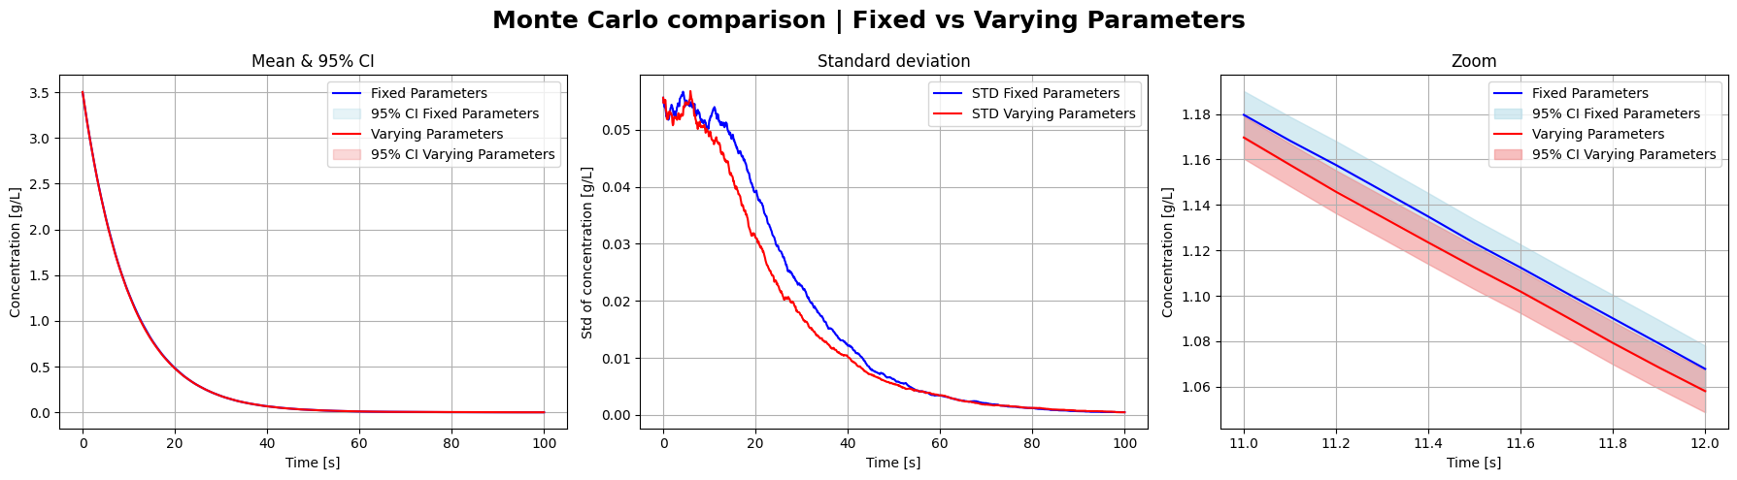
Monte Carlo Fixed Vs Varying
Notes:
To better compare the two, we can show them on the same graph
The means are identical
The STD changes slightly
Again, particle adds sampling noise

Slide 9
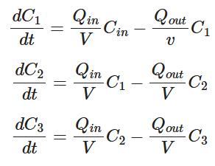
Three Tank Governing Equations
Delay & Decay
Upstream Tank Affects Downstream
Notes:
The second tank is affected by the first
The third tank is affected by the 2nd

Slide 10
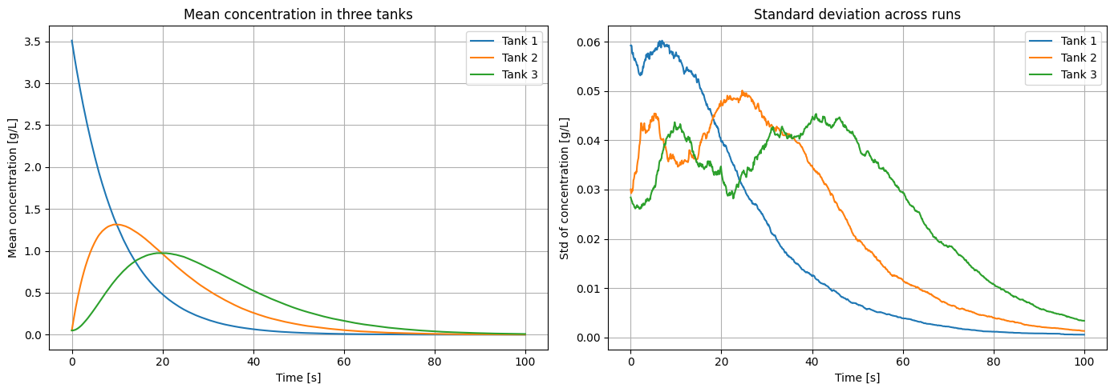
Notes:
Again, we use the particle probability Monte Carlo for our simulations

Slide 11
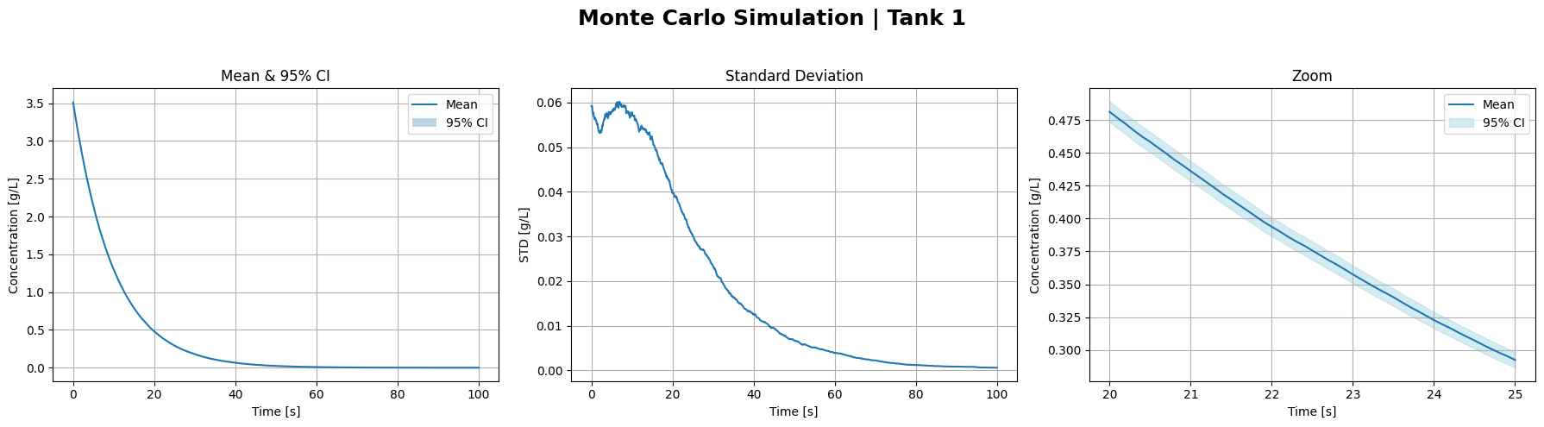
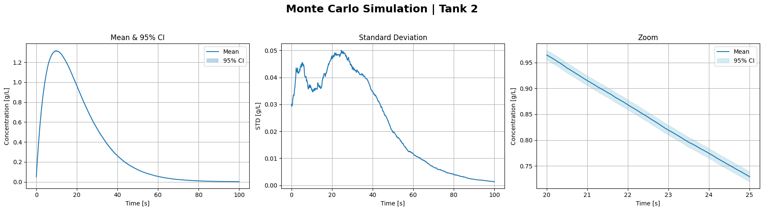
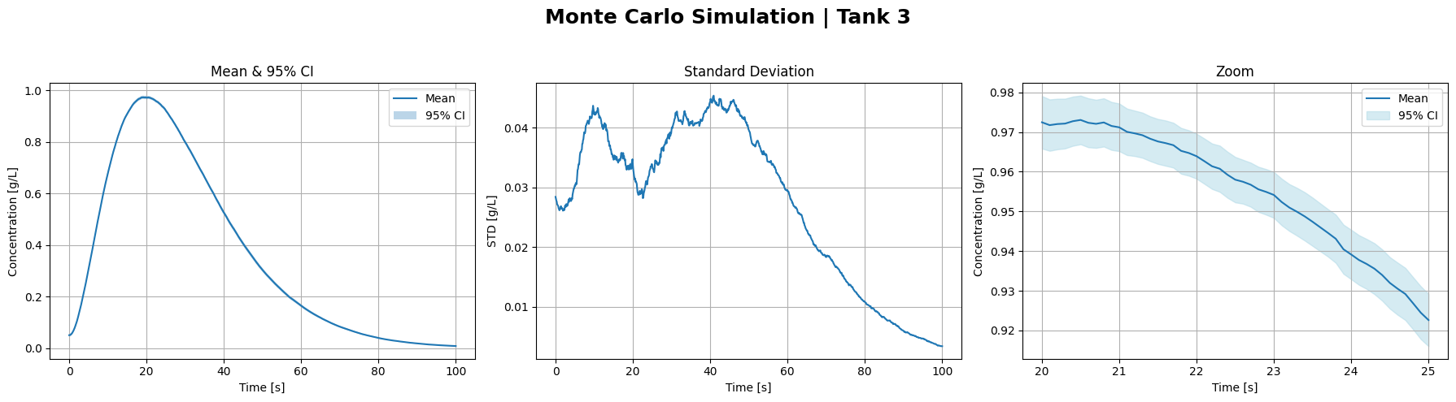
Notes:
Here, we clearly see ow the latter tank affects the previous
Means have a peak (later and later)
NB: Magnitude decreases downstream
STD has later and higher peaks based on flow from previous tank (and initial concentration in own tank)

Slide 12
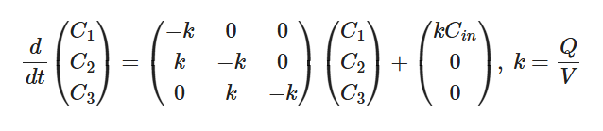
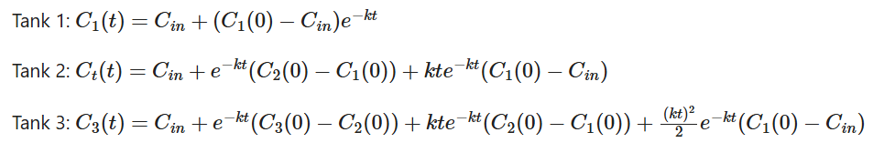
Analytical ODE Validation
Notes:
We solve a 3x3 linear system to find our constants for the three tanks:
Tank 1 is exponential
Tank 2 has added te^-kt
Tank 3 has added te^-kt and t^2e^-kt

Slide 13
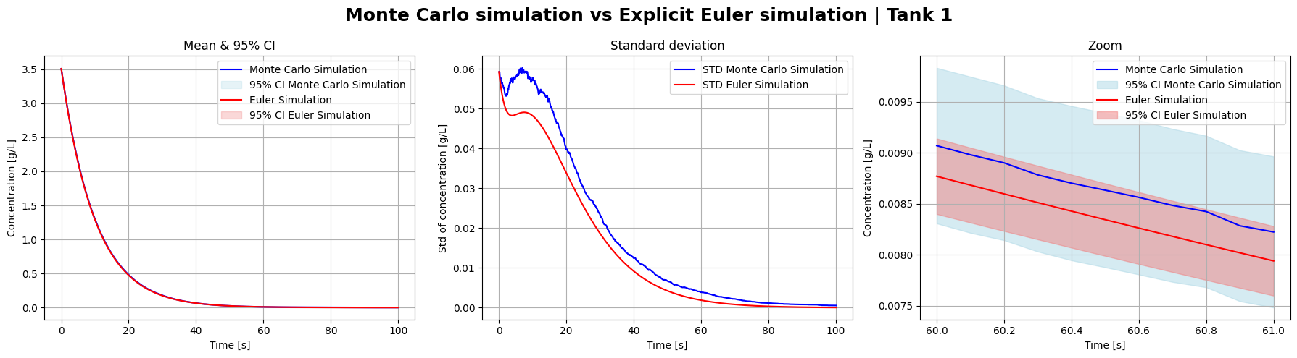
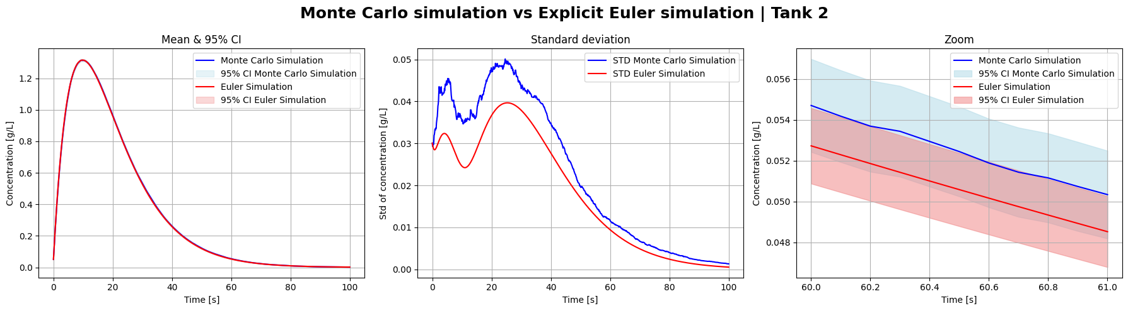
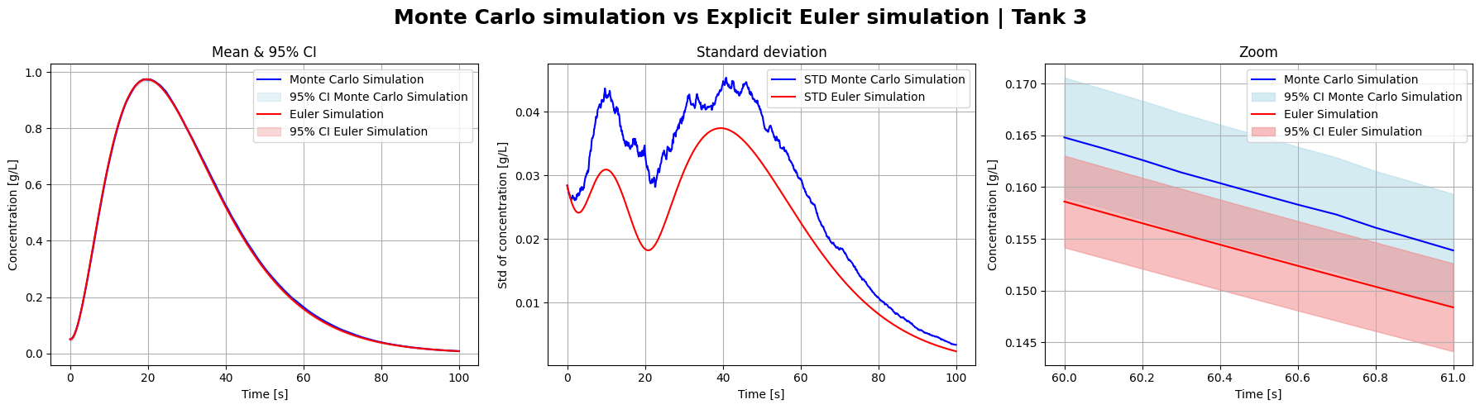
Notes:
Mean curves are visually identical
Differences only in STD
Follow expected behavior of 3 tank system, where latter tank inherits from prior tank
Some deviations from the Explicit Euler, but these differences are minor
Again, this confirms the correctness of our simulations

Slide 14

Accuracy & Computational Efficiency
Monte Carlo Mean $≠$ Deterministic ODE
Unbiased Estimator
Variance Decays Over Time
Cost
  Deterministic: 1 Solve
  Monte Carlo: 100 Solves
Notes:
We therefore gain uncertainty quantification at the expense of runtime

Slide 15
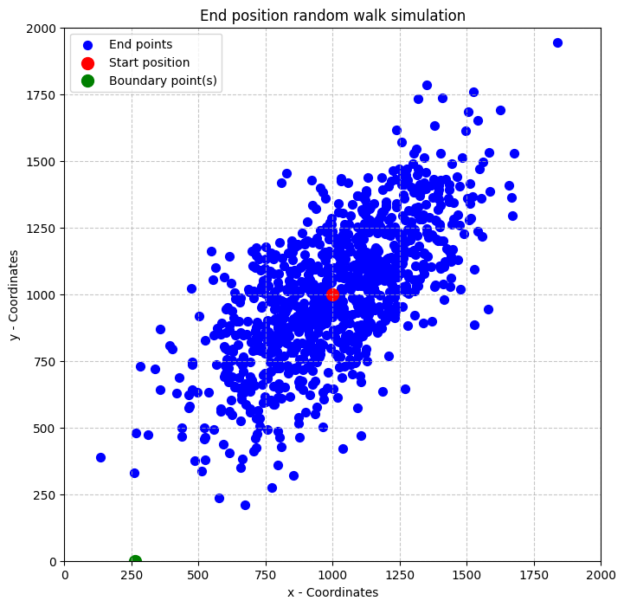
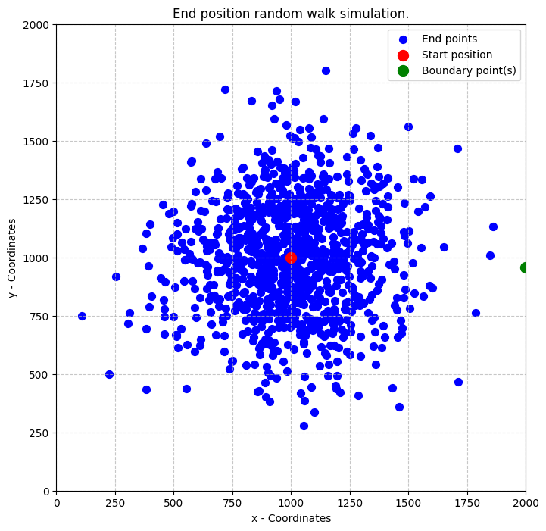
Random Walks In Aquifers
Pollutant Spreading
Groundwater Transport
Weighted vs
Unweighted

Slide 16
Unbiased Walk
Record Arrival Time At 10km
Large Spread In Interval Times
Some Runs Take Extremely Long

Slide 17

Biased Random Walk
Modified Spread
  $p_{South}=2p_{North}$
  East & West Are Equal
Much Faster Arrival
Narrow Distribution

Slide 18
Risk Comparison
Unbiased Vs Biased
Risk Interpretation
  Downward Stream = High Risk
  Upward Stream = Negligible Risk

Slide 19
Conclusion & Learning Outcomes
Key Results
  Monte Carlo Reproduce ODE Means
  CI Quantify Uncertainty
  Directional Bias Drastically Increases Contamination Speed
Summary
  Deterministic ODE
    Fast & Accurate
  Monte Carlo
    Expensive But Informative
Notes:
Both methods have value
Monte Carlo is best when risk and uncertainty are central

Slide 20
Conclusion & Learning Outcomes
Stochastic modeling approach based on Monte Carlo methods
Understand the principles of Monte Carlo methods and their application in stochastic modelling.
Develop skills in formulating and solving mass balance equations for single and interconnected systems.
Quantify uncertainties in simulation results and interpret their implications for system behavior.
Compare stochastic simulation outcomes to deterministic ODE solutions, critically analyzing their performance and limitations.
Gain hands-on experience with computational tools for solving engineering problems.

